Slide 1

The Most Featureful, Smart, Easy & Affordable
Event Ticketing and
Box-Office System

Slide 2


A Comprehensive Solution for All Your Online Business, in One Fully Integrated Package

Slide 3
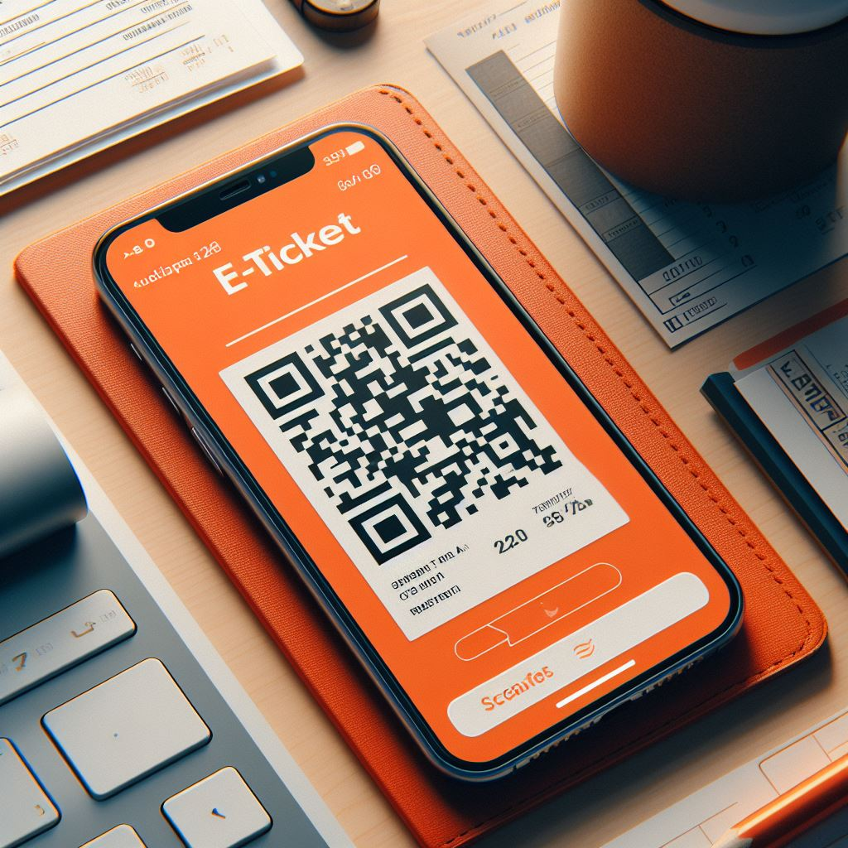
All Your Online Ticketing Needs
QR Codes
Seating Charts
Coupons
Season Passes
Membership
Recurring Event
Bundles / Packages
Timed Events
Online Events
Exchanges
Returns

Slide 4

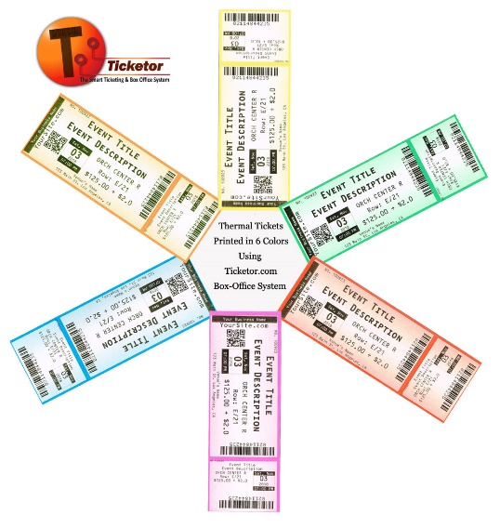
All Your
Box-Office Needs
Ticket Booth
On-The-Go
Over-The-Phone
Cash
Credit Card
Thermal Tickets
Card Reader
Cash Register

Slide 5

Website Builder & Content Management

Slide 6


Advanced Marketing, Integrated Newsletter & Text Marketing

Slide 7

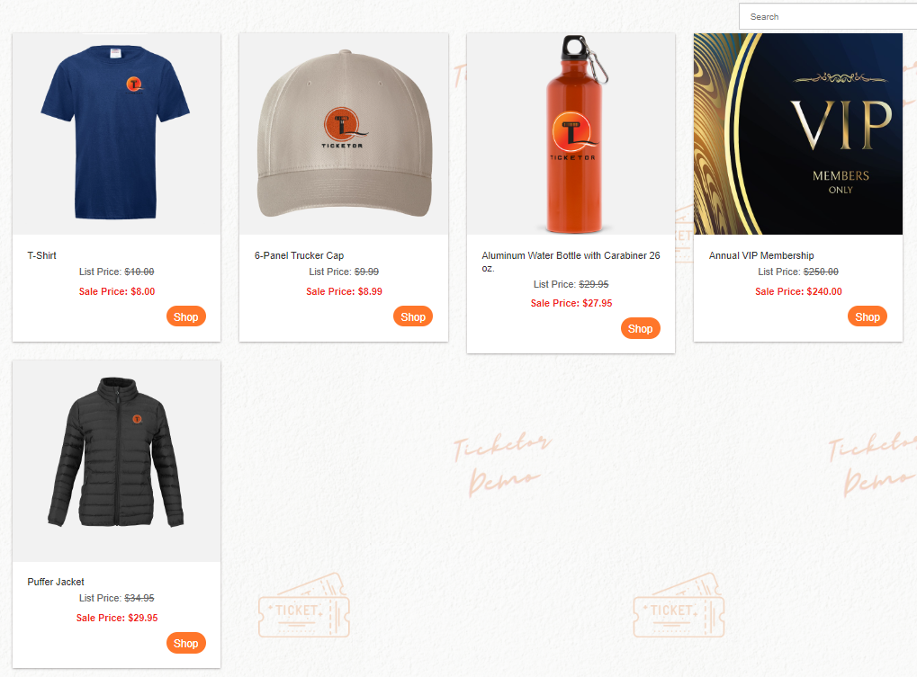
Online-Store

Slide 8


Giftshop

Slide 9

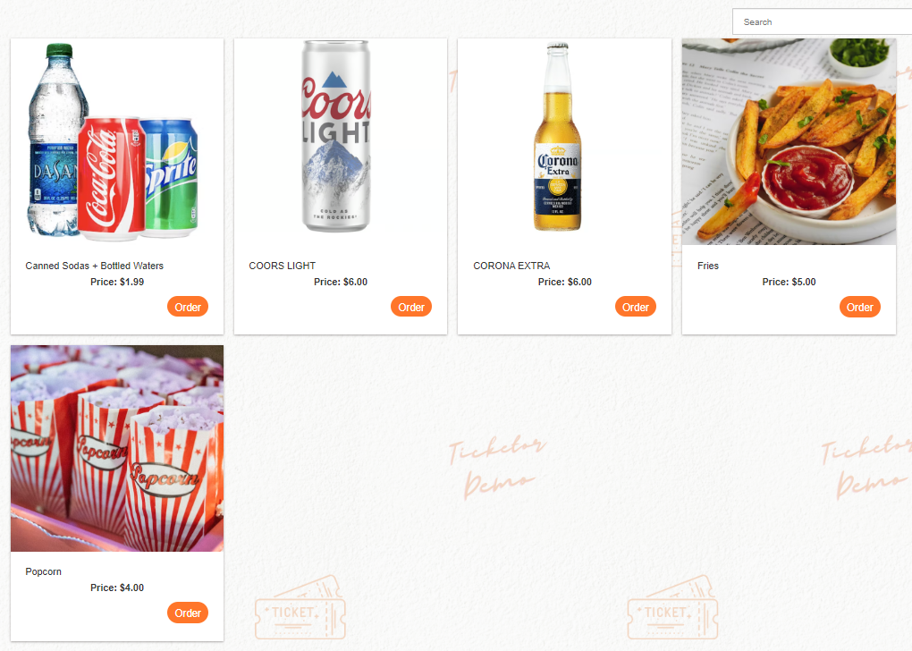
Concession

Slide 10

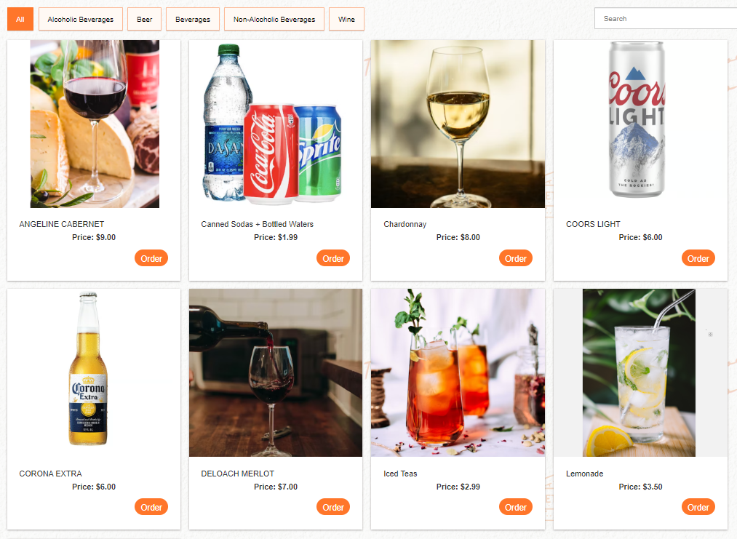
Bar & Drinks
Order From Seat or POS

Slide 11

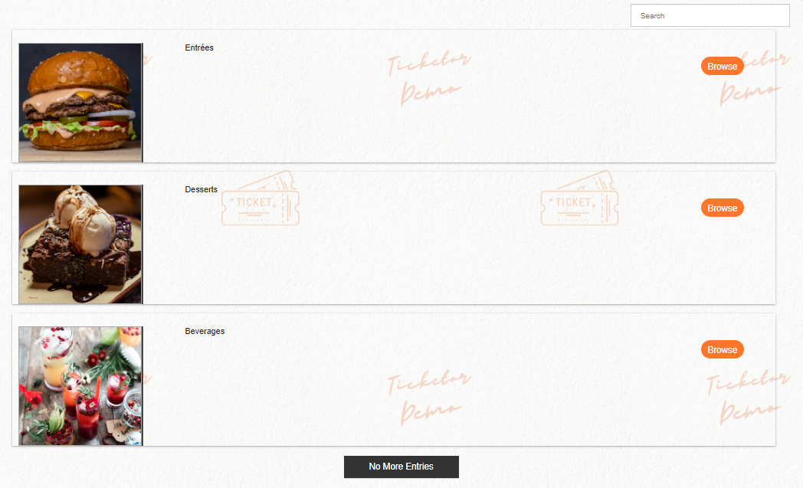
Restaurant or Food Stand

Slide 12

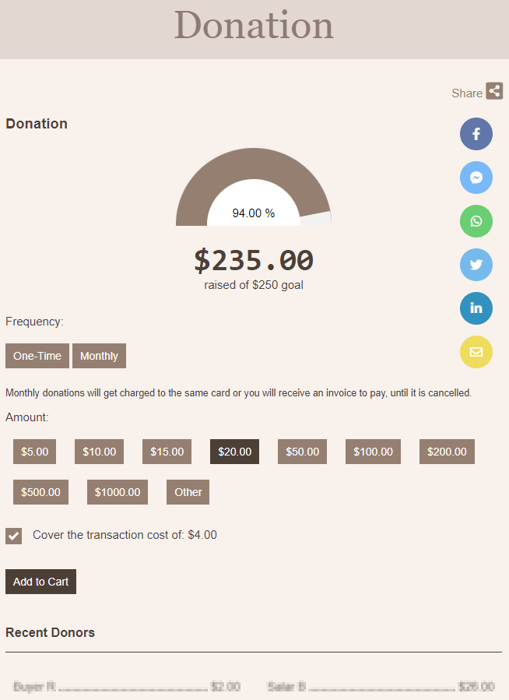
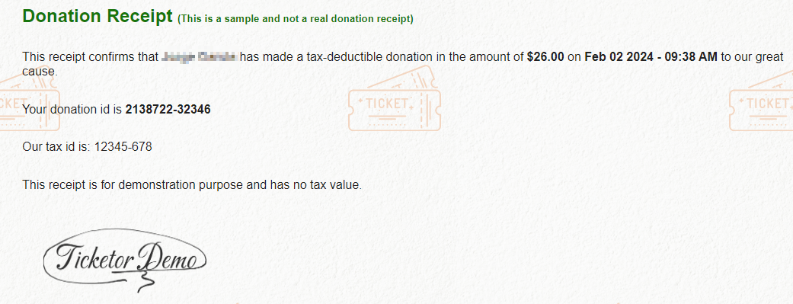
Donation Collection & Donor Management

Slide 13

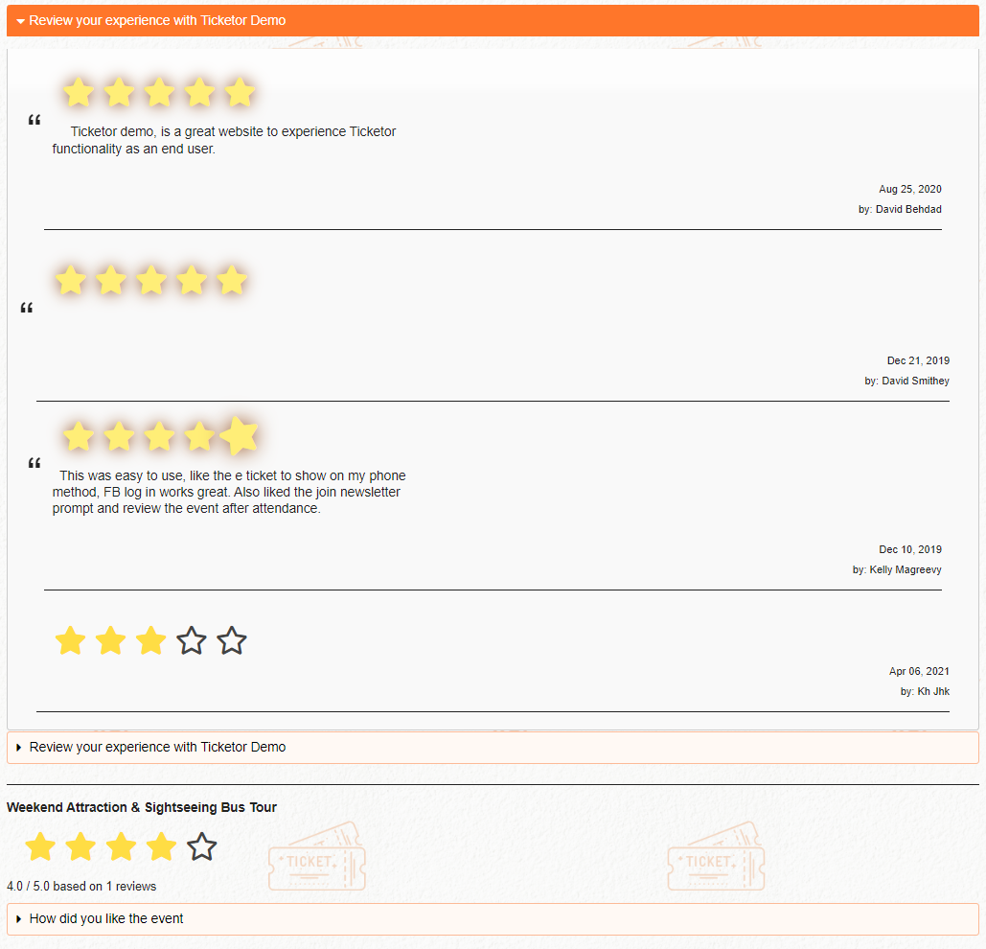
Reviews &
Reputation Management

Slide 14

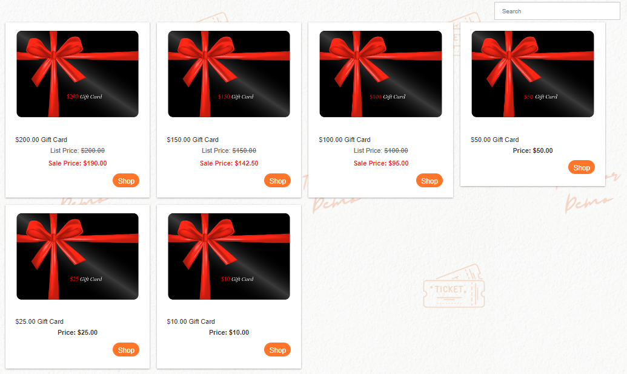
Gift Cards
System

Slide 15
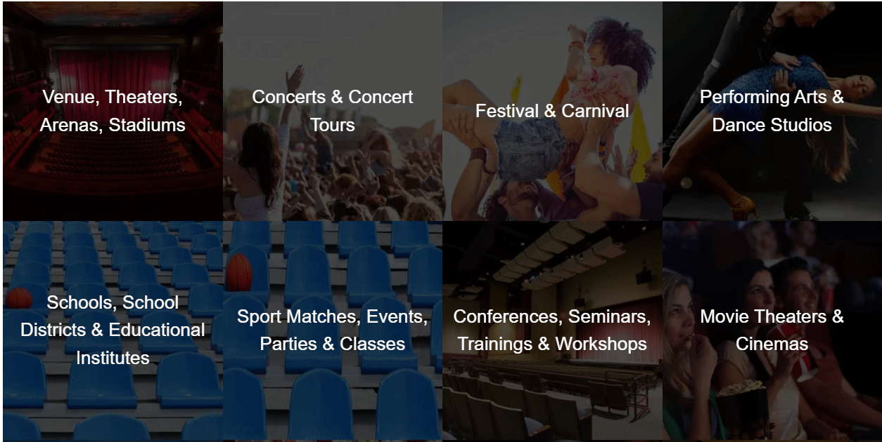
Specifically Designed For

Slide 16

Specifically Designed For

Slide 17
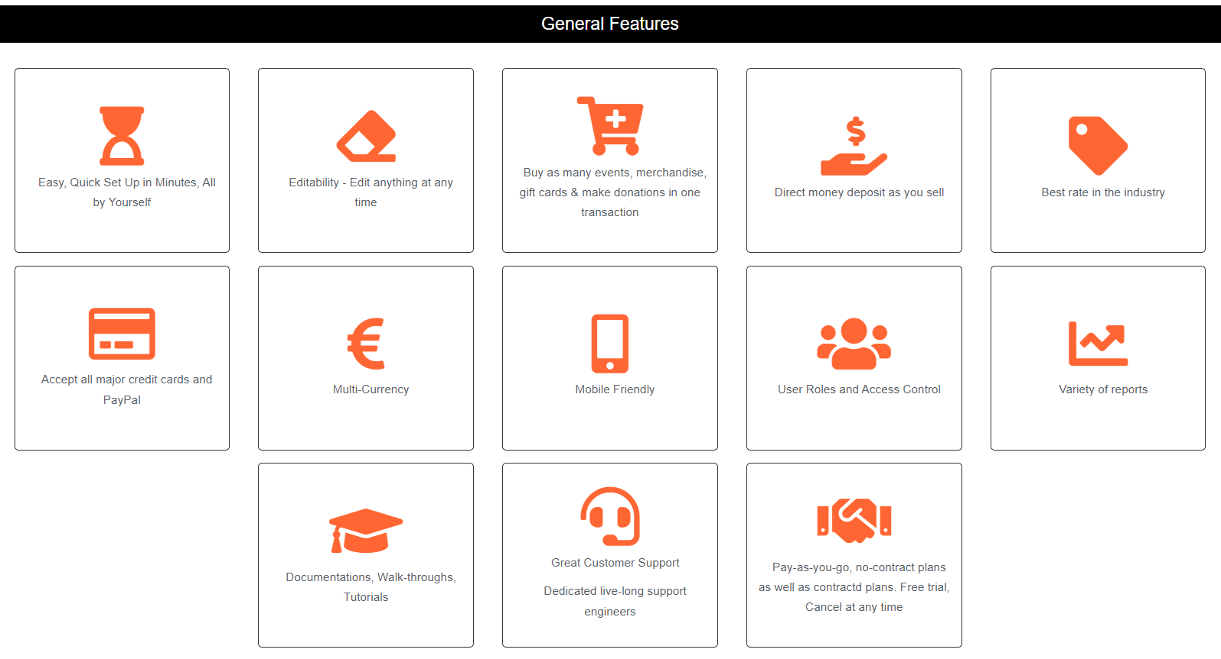

With Great Features

Slide 18
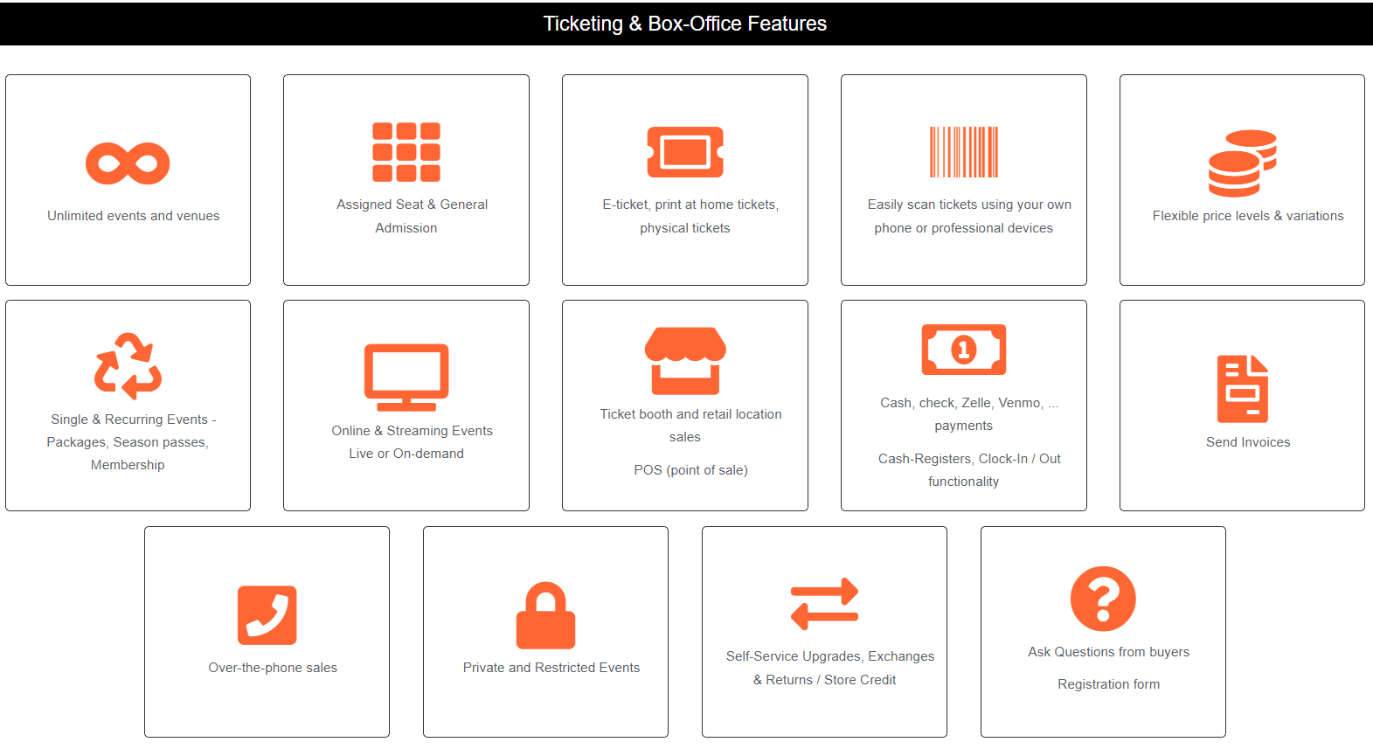
With Great Features

Slide 19
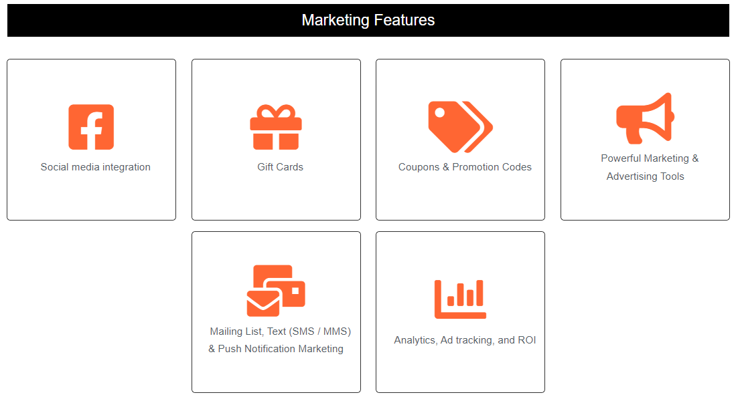

With Great Features

Slide 20
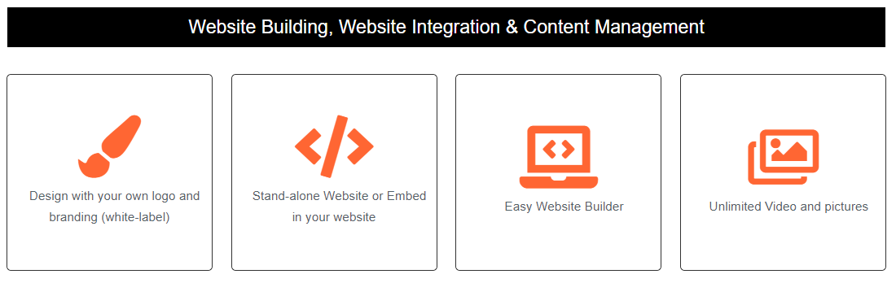

With Great Features

Slide 21
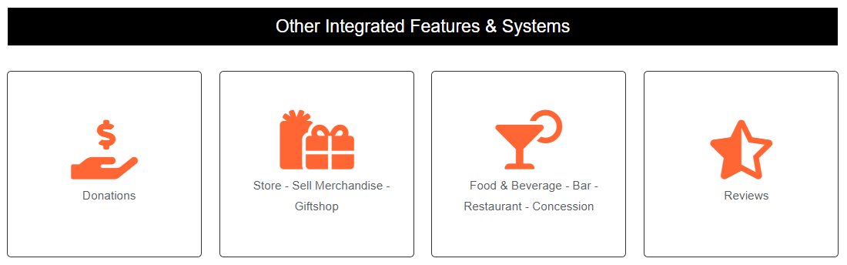
With Great Features

Slide 22

BEST RATE IN THE
INDUSTRY

Slide 23
Ticketor refunds your fee when you refund tickets
You set the buyer fees and you collect them
Receive the sales money directly as you sell using your own payment processor

Slide 24
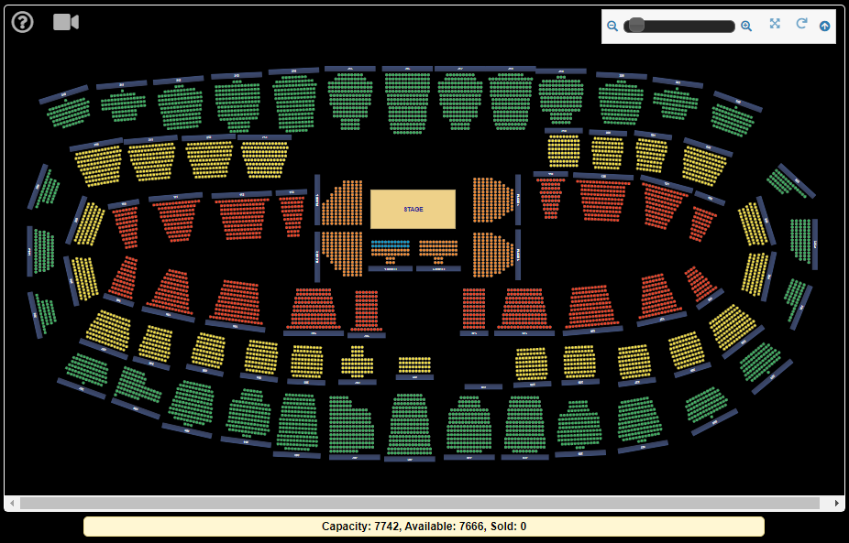
The Complete Seating Chart in One View

Slide 25
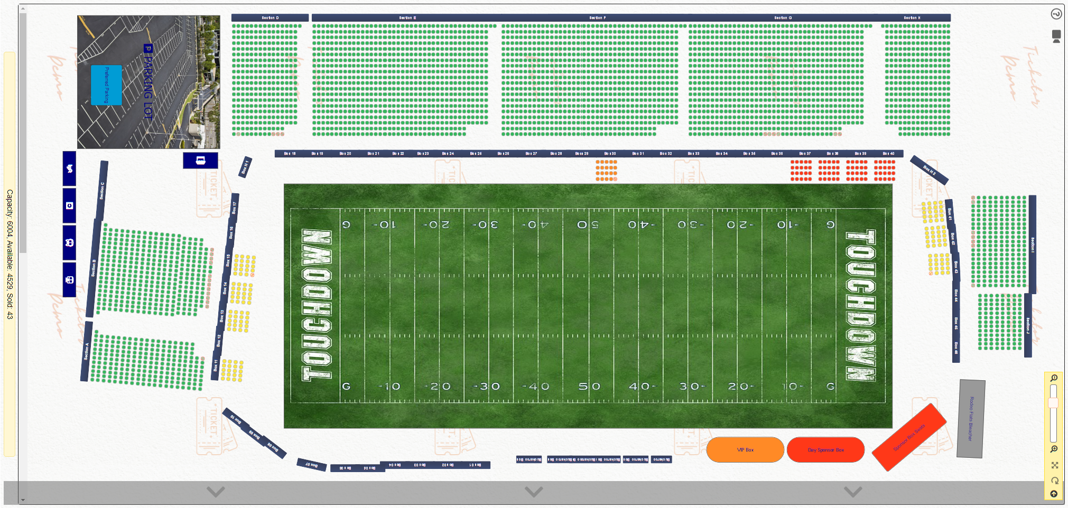
The Complete Seating Chart in One View

Slide 26
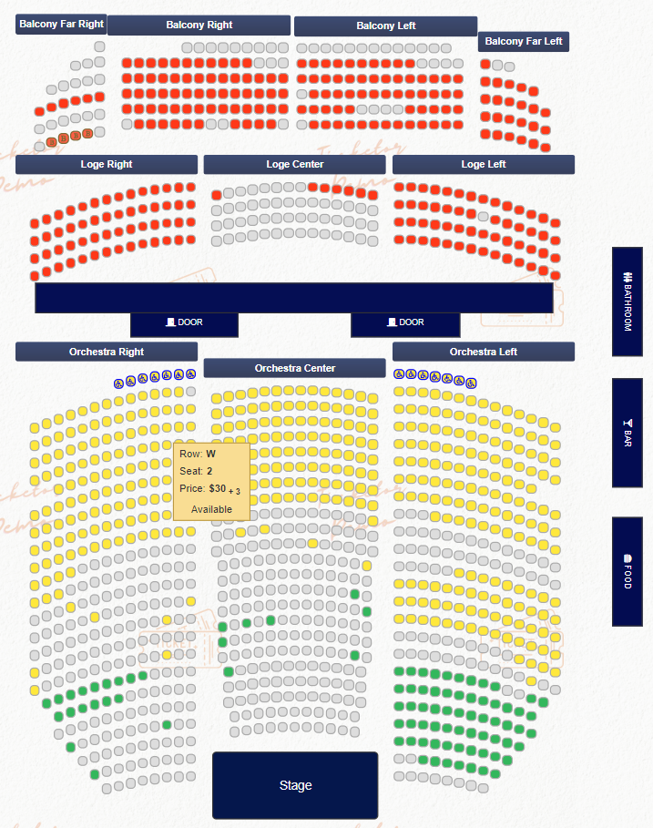
The Complete Seating Chart in One View

Slide 27
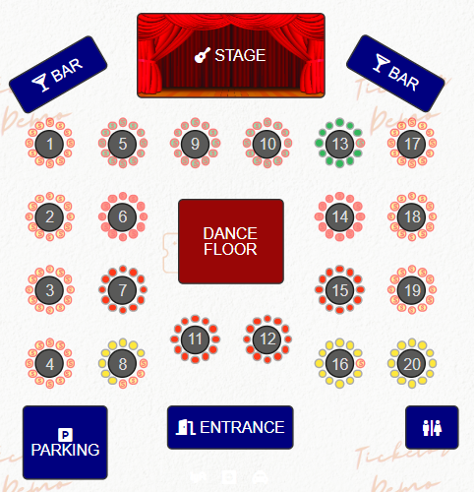
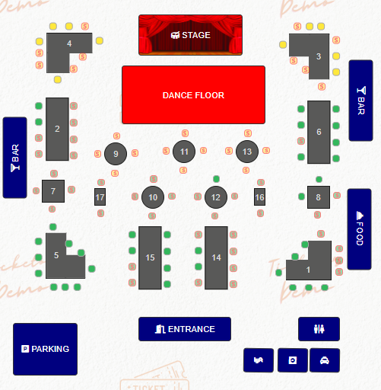
The Complete Seating Chart in One View

Slide 28











All Payment Processors / Methods

Slide 29
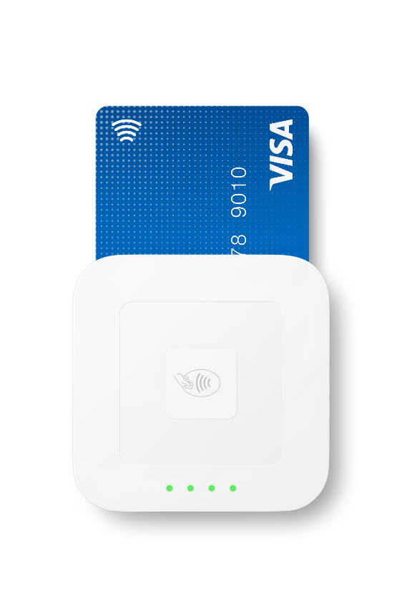
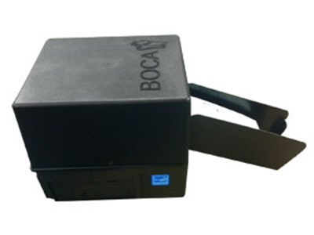
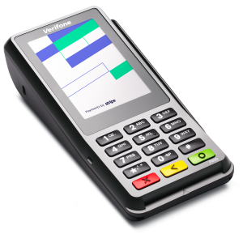
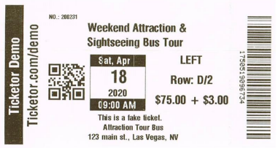
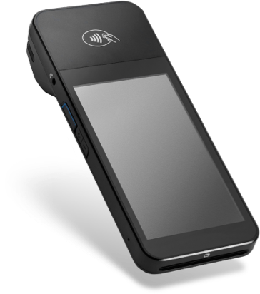
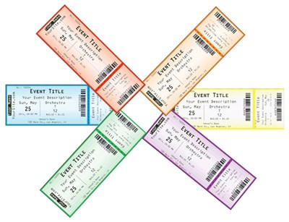
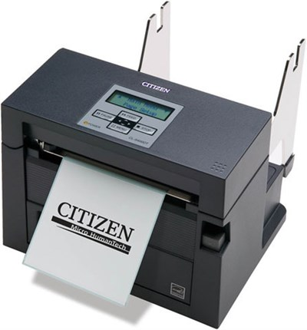
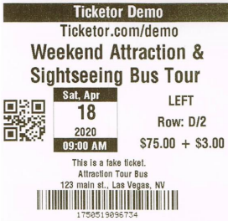
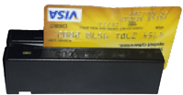
All Devices

